Slide 1
國立陽明交通大學
112 學年度 基科所碩士口試
建立一般病房對於心臟驟停的早期預警系統
Establish an early warning system for cardiac arrest in the general ward
Student：Nien-En Li (李念恩)
Advisor：Kun-Pin Wu Ph.D. (巫坤品博士)
Date：2024/07/18

Slide 2
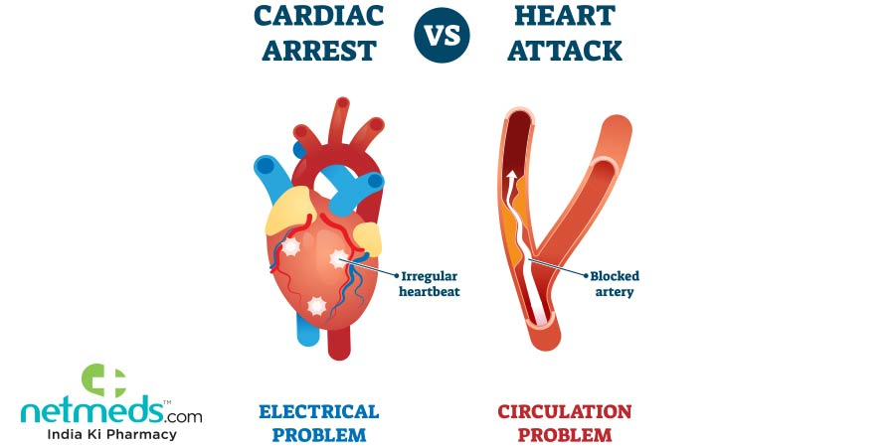
Cardiac arrest (CA)
Cardiac arrest refers to the heart ceasing its normal beating, losing its ability to pump blood throughout the body.
The main causes of cardiac arrest are arrhythmia and myocardial infarction.
Circulation, 2004. 110(21): p. 3385-97.
Jama, 2019. 321(12): p. 1200-1210.
per year | U.S | Taiwan
IHCA | > 290,000 | > 6,000
survival rate of IHCA | 22.4% | 11.8%
OHCA | > 350,000 | > 9,000
survival rate of OHCA | 9.3% | 10.9%
Circulation, 2022. 145(8): p. e153-e639.
Circulation, 2024. 149(8): p. e347-e913.
in-hospital cardiac arrest, IHCA
out-of-hospital cardiac arrest, OHCA
Journal of the Chinese Medical Association, 2016. 79(1).
PLoS One, 2015. 10(4): p. e0122675.

Slide 3
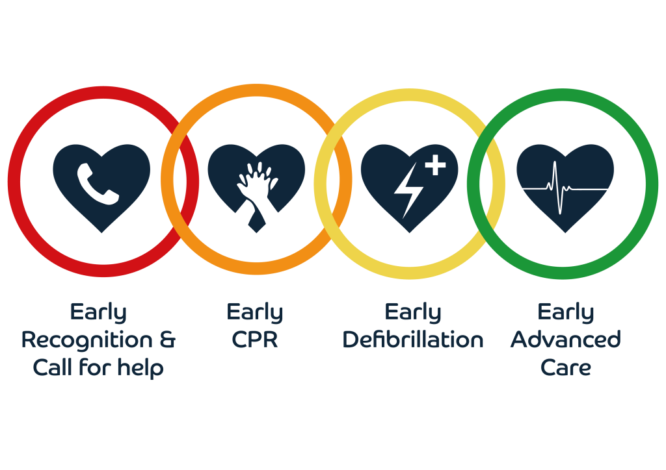
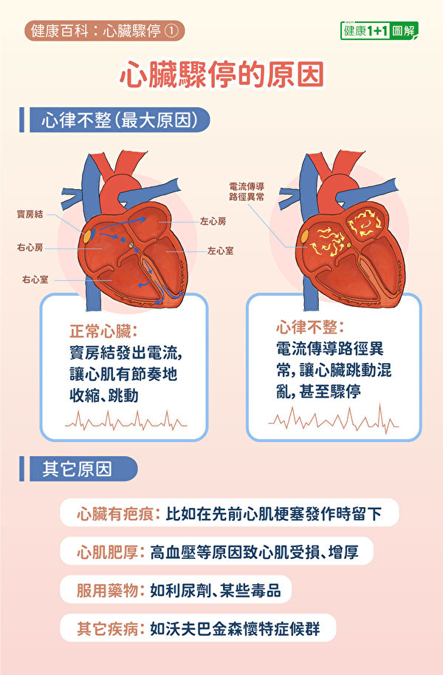
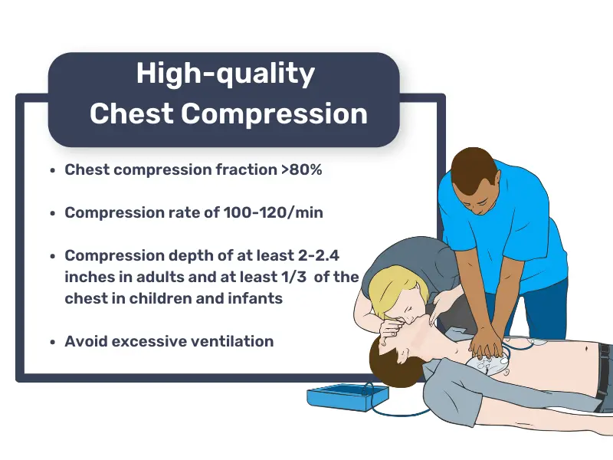

Slide 4

Cardiac arrest (CA)
When cardiac arrest occurs, the patient will be under a high risk of death.
Cardiac arrest is a disease worth studying and trying to reduce its incidence.
About 84% of cardiac arrest events have observable signs within 8 hours.
Resuscitation, 2002. 54(2): p. 115-123.
Resuscitation, 2016. 98: p. 112-117.
Most cardiac arrest events can be avoided.

Slide 5
Rapid response systems (RRS)
Rapid response systems (RRS) have been shown to enable early detection and proper intervene in patients exhibiting signs of clinical deterioration.
N Engl J Med. 2011;365:139–46.
Track-and-trigger systems are part of the afferent limb of the RRS for monitoring patients, detecting deterioration, and activating the RRS.
Resuscitation. 2010;81:375–82.
In general, these can be categorized as single-parameter track-and-trigger systems (SPTTS) or multiple-parameter track-and-trigger systems (MPTTS).

Slide 6
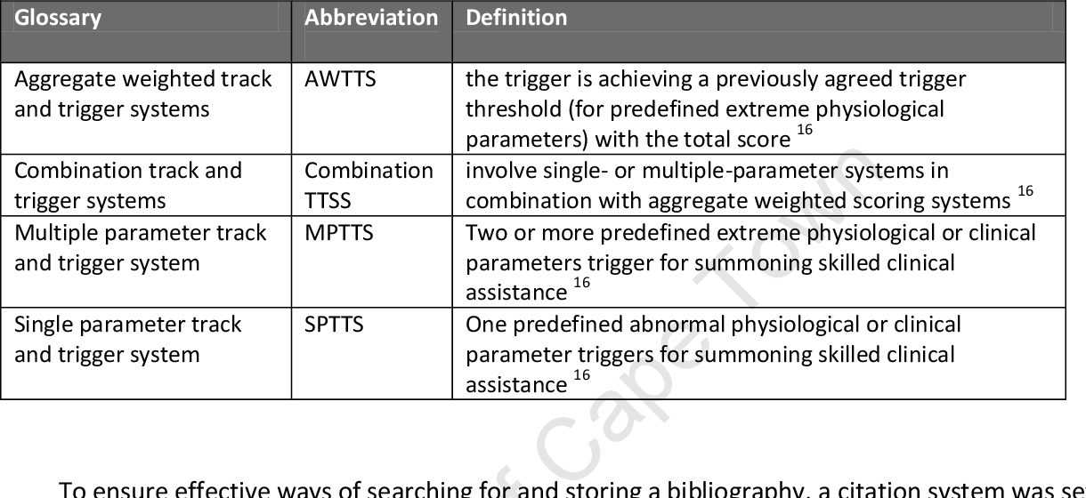
SPTTS & MPTTS
http://hdl.handle.net/11427/11688
The modified early warning score (MEWS) and national early warning score (NEWS) are the most widely used MPTTS.
JAMA Netw Open. 2020;3: e205191.
MEWS & NEWS have better predictive values for IHCA and are more efficient in detecting clinical deterioration than SPTTS.
Resuscitation, 2008. 79(1): p. 11-21..
J Am Heart Assoc. 2018;7.
IHCA：in-hospital cardiac arrest

Slide 7
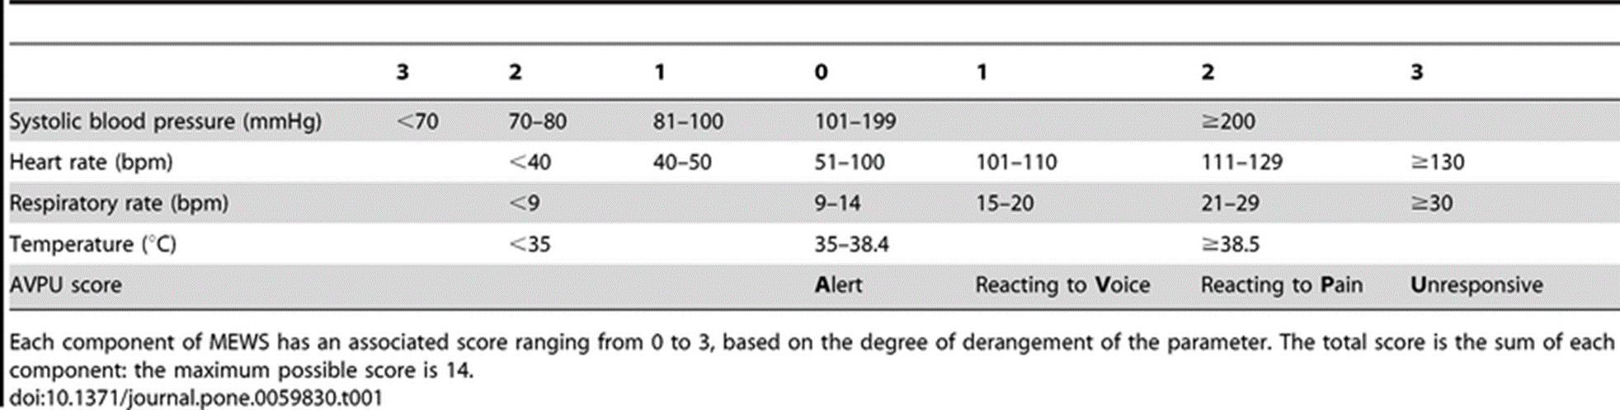
Modified Early Warning Score (MEWS)
Score
Vital signs
Clin Intensive Care, 1997. 8(2): p. 100.
Each value corresponds to a different score. The higher the total score, the more serious the condition of patients is.
If the total score exceeds 5, the medical professional will be alerted to the need for treatment.
Anaesthesia, 2005. 60(6): p. 547-53.
European Journal of Anaesthesiology | EJA, 2012. 29(3).
https://www.researchgate.net/figure/Calculation-of-the-Modified-Early-Warning-Score-MEWS_fig1_236106651

Slide 8
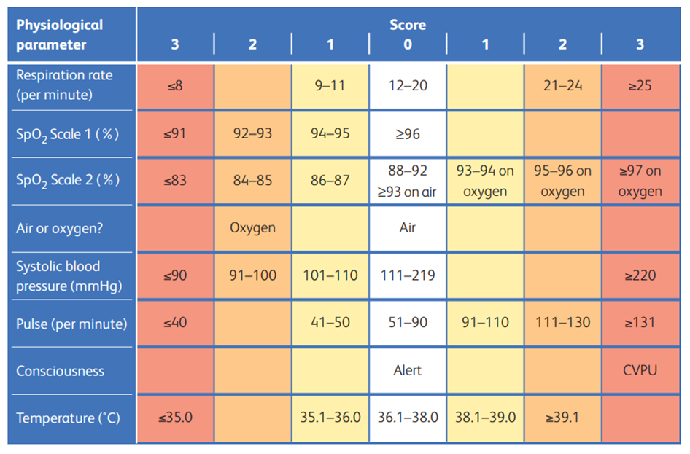
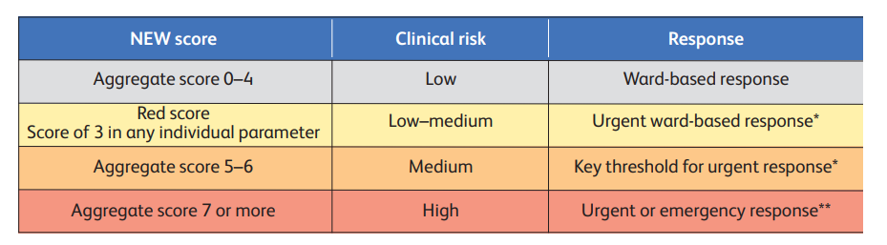
National Early Warning Scores (NEWS)
The measured items and value ranges cannot be changed by hospital or by department.
Clinical Medicine, 19(3).

Slide 9
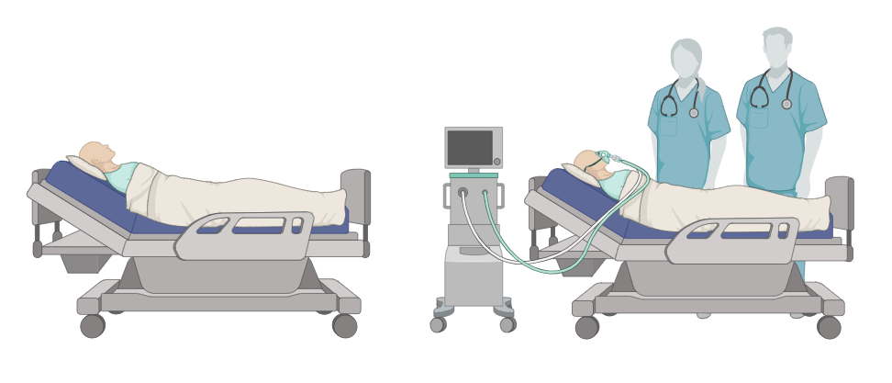
The situation of early warning systems in hospital units
Early warning systems are mostly set up in ICU.
ICU are equipped with more medical manpower than general ward.
Medical equipment and professionals continuously monitor each patient.
Intensive care unit (ICU)
PLoS One. 2022; 17(3): e0265559.
Ir J Med Sci, 2022. 191(3): p. 997-1003.
The vital signs are measured every 4-6 hours.
Once cardiac arrest occurs, it is not easily detected immediately.
General ward
Data Brief. 2017;16:612-616.
Int J Nurs Stud. 2017;74:A1-A4.
9

Slide 10
Related work
Most research focused on in-hospital cardiac arrest (IHCA), which means they didn't differentiate general ward, ICU and emergency rooms.
Diagnostics 2021, 11(7), 1255.
About 59% of IHCA occurred in the ICU, this means that most studies developing models that can predict cardiac arrest are actually predicting cardiac arrest in the ICU.
J Am Heart Assoc. 2016;5(10):e003638.
Medical data on general wards is not easy to obtain, so there are still fewer studies on cardiac arrest in general wards than in ICU or emergency room.
J Clin Med. 2019;8(9):1336.
Am J Emerg Med. 2020;38(1):43-49.

Slide 11
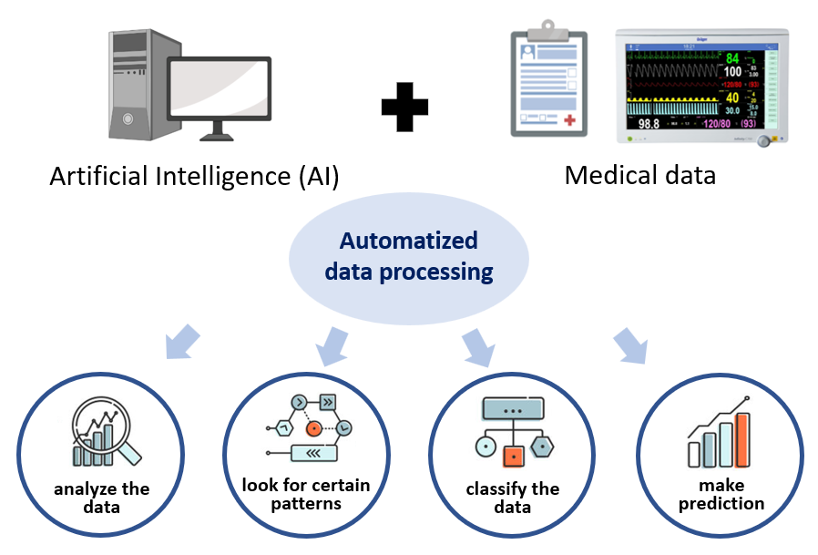
Related work
MEWS and NEWS are mostly used to predict IHCA. However, many studies have shown that the performance of these two systems is not stable. For example, they may have low sensitivity and high false alarm rates.
Resuscitation, 2013. 84(4): p. 465-470.
J Am Heart Assoc. 2018;7(13).
Resuscitation. 2021;163:78-85.
Today's information systems can automatically collect and analyze medical data to develop systems that predict patient deterioration.

Slide 12
Related work
Many studies have developed machine learning-based algorithms for predicting IHCA.
Some models need to rely on a large number of features, which may easily cause the model to overfit, and also limit the use occasions and opportunities of the model.
Missing data may reduce the prediction performance of the model, so it is still difficult to apply these models in actual clinical settings.
JMIR Med Inform, 2021. 9(12): p. e30798
Clin Cardiol, 2021. 44(3): p. 349-356
Neurocomputing, 2018. 300: p. 70-79.
Deep learning outperforms MEWS, NEWS, and traditional machine learning in event prediction.
Deep learning can effectively control and learn from data with multiple features, and it also demonstrates stability in handling missing data.
arXiv preprint arXiv:1511.03677, 2015.
nature, 2015. 521(7553): p. 436-444.

Slide 13
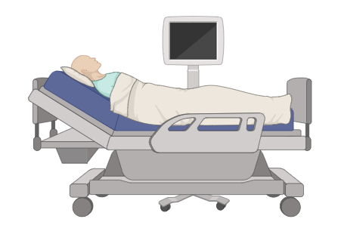

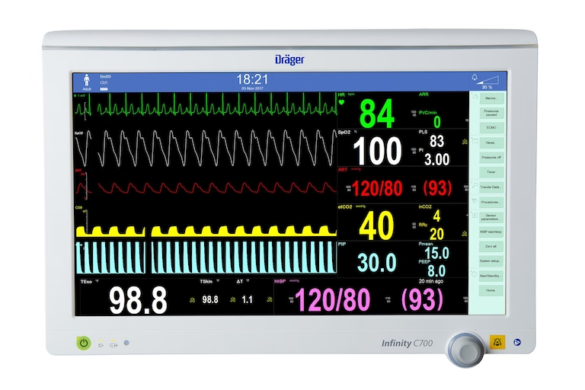


Aim
Simulate
Create
Predict
Clinical medical database
Frequency and items of measurement
Deep learning-based
early warning system
CA patients in
general ward
vs.
NEWS (Traditional trigger system)
13

Slide 14
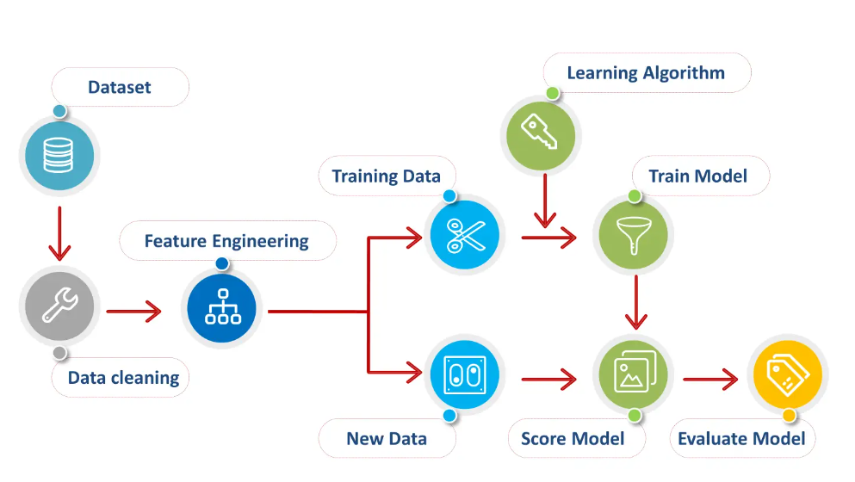

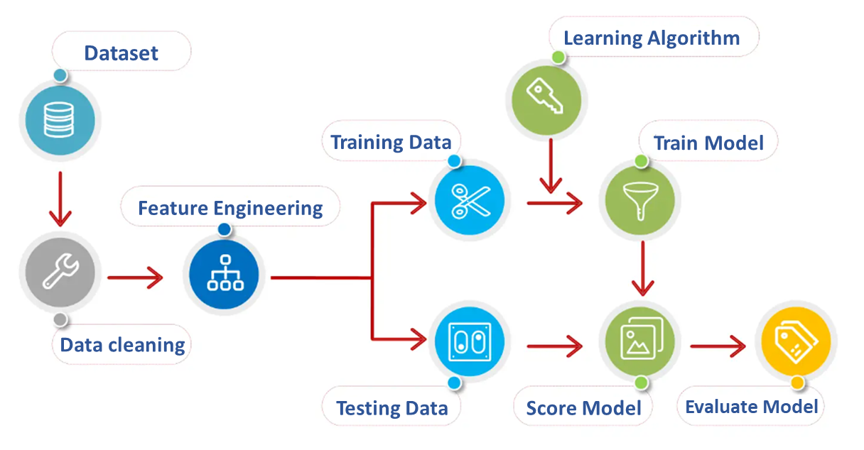

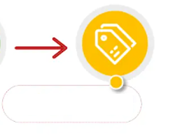
Model architecture
Training model
Dataset
Learning Algorithm
80%
Training Data
Train Model
Feature Engineering
Change hyperparameters
Data cleaning
20%
Test Data
Score Model
Evaluate Model
External validation
External cohorts
Model
Evaluate Model

Slide 15
Overview of study design
MIMC-IV
(Public database)
Data screening
Patients who suffered cardiac arrest
Feature extraction
Stay_id, Vital signs, Measured time , CA time
Data pre-processing
Outlier detection, Imputation
Select positive/negative samples
From CA / From CA or Non-CA
Model construction
RNN, LSTM, GRU, CNN-LSTM
Evaluate Model
Accuracy, Sensitivity, AUROC
External validation

Slide 16
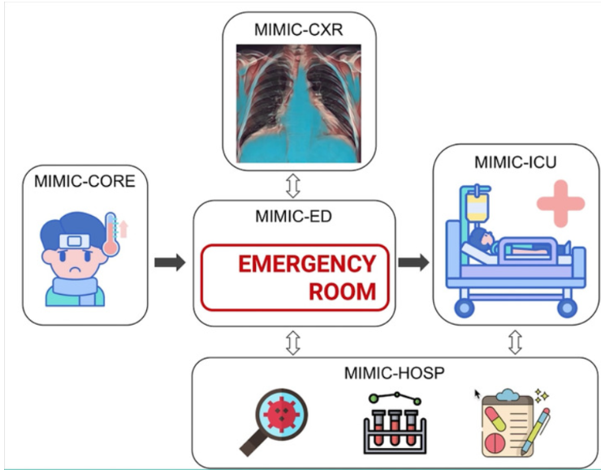
Participants and data sources
Medical Information Mart for Intensive Care (MIMIC)
Beth Israel Deaconess Medical Center, United States
2008-2019
Over 40,000 ICU patients
MIMC-IV
(Public database)
Large-scale clinical database
Rich clinical characteristics data
De-identified medical records
Scientific data, 2023. 10(1): p. 1.

Slide 17
Overview of study design
MIMC-IV
(Public database)
Data screening
Patients who suffered cardiac arrest
Feature extraction
Stay_id, Vital signs, Measured time , CA time
Data pre-processing
Outlier detection, Imputation
Select positive/negative samples
From CA / From CA or Non-CA
Model construction
RNN, LSTM, GRU, CNN-LSTM
Evaluate Model
Accuracy, Sensitivity, AUROC
External validation

Slide 18
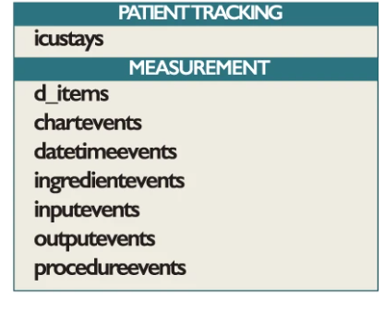
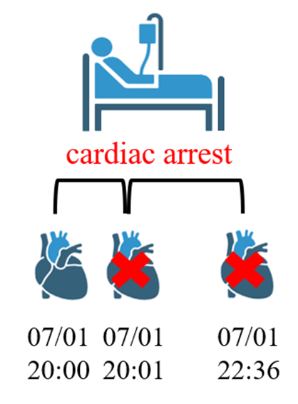
Target population
procedureevents：
This table records the events that occurred during the hospitalization of these patients.
cardiac arrest
code：225466
CA patients
This study only used the records of the first cardiac arrest event, and subsequent cardiac arrest events were excluded.
07/01
20:00
07/01
20:05
07/01
22:36
Scientific data, 2023. 10(1): p. 1.

Slide 19
Overview of study design
MIMC-IV
(Public database)
Data screening
Patients who suffered cardiac arrest
n = 575
Feature extraction
Stay_id, Vital signs, Measured time , CA time
Data pre-processing
Outlier detection, Imputation
Select positive/negative samples
From CA / From CA or Non-CA
Model construction and evaluation
RNN, LSTM, GRU & AUROC, F1-score
Feature importance
SHAP
External validation
19

Slide 20

Feature Extraction
Stay_id
Gender
Age
Vital signs (Features)
Measured time of vital signs
Time of cardiac arrest
Features | Code
Non-invasive systolic blood pressure (SBP) | 220179
Non-invasive diastolic blood pressure (DBP) | 220180
Heart rate (HR) | 220045
Respiratory rate (RR) | 220210
Body temperature (BT) | 223762
Oxygen saturation (SpO₂) | 220277
These are basic vital signs measured daily in general ward patients.
Use the MIMIC-code provided by MIT-LCP to check whether the data of vital signs and the range of each variable are correct.
Journal of the American Medical Informatics Association, 2018, 25.1: 32-39.

Slide 21
Overview of study design
MIMC-IV
(Public database)
Data screening
Patients who suffered cardiac arrest
n = 575
Feature extraction
Stay_id, Vital signs, Measured time , CA time
148334 vital signs
Data pre-processing
Outlier detection, Imputation
Select positive/negative samples
From CA / From CA or Non-CA
Model construction and evaluation
RNN, LSTM, GRU & AUROC, F1-score
Feature importance
SHAP
External validation
21

Slide 22
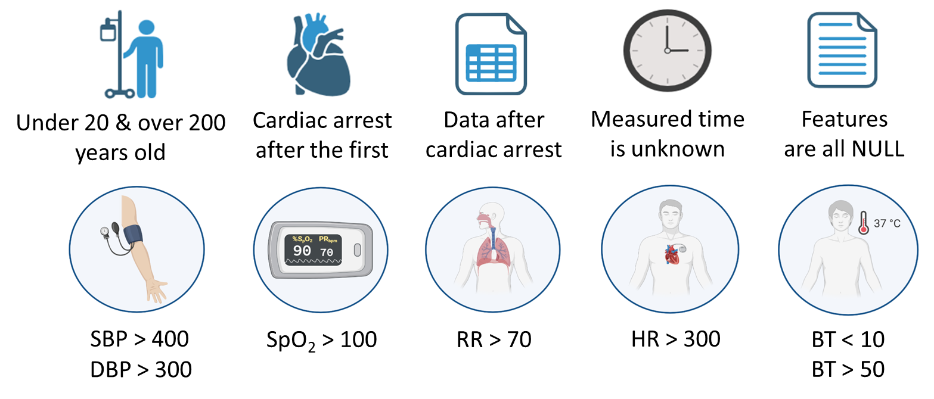
Data pre-processing
Remove some data according to the following rules :
Use linear interpolation to impute missing values for each patient with missing data.
If there is missing data that cannot be imputed, the nearest available value will be used directly.
22
Journal of Physics: Conference Series. Vol. 1754. No. 1. IOP Publishing, 2021.

Slide 23
Overview of study design
MIMC-IV
(Public database)
Data screening
Patients who suffered cardiac arrest
n = 575
Feature extraction
Stay_id, Vital signs, Measured time , CA time
148334 vital signs
Data pre-processing
Outlier detection, Imputation
n =479
68973 vital signs
Select positive/negative samples
From CA / From CA or Non-CA
Model construction and evaluation
RNN, LSTM, GRU & AUROC, F1-score
Feature importance
SHAP
External validation
23

Slide 24


The goal of predictive model
We aim to use data from the 24 hours (six measurement points) prior to the prediction point (T) to predict the likelihood of a cardiac arrest occurring in the T+1 to T+4 hour window.
The one-hour lead time between T and T+1 is intended to give medical staff sufficient time to prepare for a potential cardiac arrest.
T
T+1
T+4
six measurement points
patients
4 hours
T：prediction point
Red region：lead time
Blue region：prediction window
Gray region：observation window
24

Slide 25
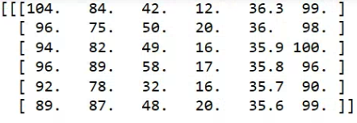
Selection of positive samples
The positive sample is to select the medical data of imminent cardiac arrest from the data of CA patients.
T-48
T
T-4
T+1
Cardiac arrest
six measurement points
CA patients
4 hours
Positive samples：
3462
Six vital signs
Six time points
25

Slide 26
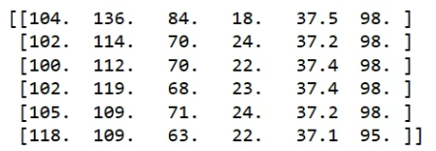
Selection of negative samples
The negative samples is to select medical data that has not yet occurred cardiac arrest from the data of CA patients.
T-48
T
T-4
T+1
Cardiac arrest
six measurement points
CA patients
4 hours
Negative samples：2757
Six vital signs
Six time points
26

Slide 27
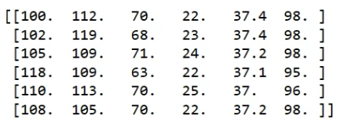
Selection of negative samples
Another type of negative sample is selected from medical data of patients who have not experienced cardiac arrest (non-CA patients).
t-48
t-4
t
six measurement points
Non-CA patients
4 hours
Negative samples：
3394
Age
Gender
Six vital signs
Six time points
CA patients
27

Slide 28
Patient characteristics
Characteristics | MIMIC IV (CA) | MIMIC IV (Non-CA) | p-value
Number of total patients, n | 477 | 477
Number of total vital signs, n | 68,973 | 55,769
Age, y , mean ± SD | 65.58 ± 15.91 | 65.58 ± 15.91
Male ,sex , n (%) | 289 (60.59%) | 289 (60.59%)
Features, mean ± SD
SBP (mmHg) | 110.69 ± 22.06 | 119.81 ± 22.60 | p < 0.05*
DBP (mmHg) | 61.96 ± 15.74 | 69.80 ± 513.42 | p < 0.05*
HR (/min) | 89.32 ± 20.88 | 84.74 ± 17.85 | p < 0.05*
RR (/min) | 21.79 ± 6.45 | 19.80 ± 5.54 | p < 0.05*
BT (℃) | 36.94 ± 1.04 | 37.00 ± 1.24 | p < 0.05*
SpO₂(%) | 96.50 ± 4.83 | 96.64 ± 5.09 | p < 0.05*
28

Slide 29
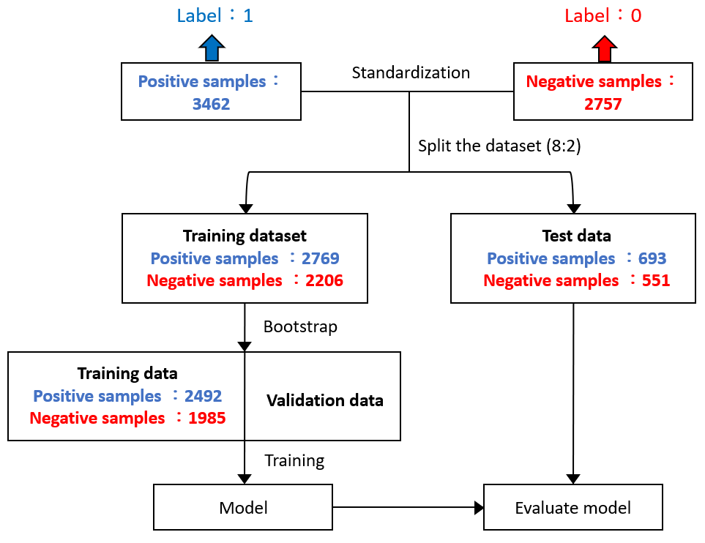
Data splitting of positive and negative samples
Positive sample：CA
Negative sample：CA
Positive sample：CA
Negative sample：Non-CA
29

Slide 30
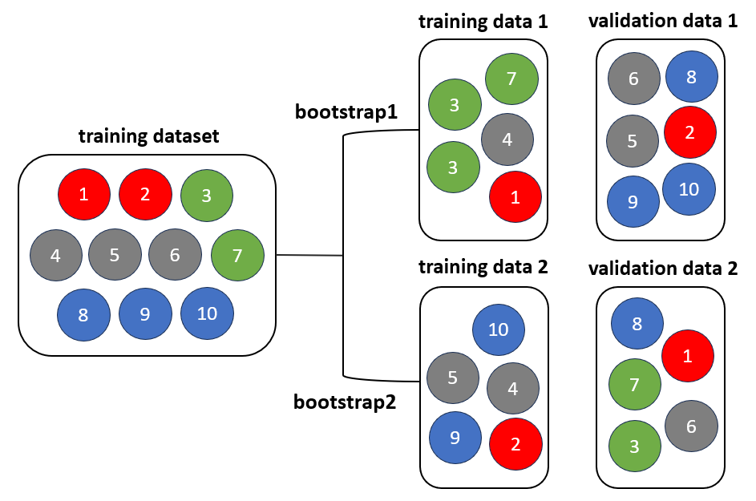
Bootstrap
Bootstrap sampling is a method that involves random and replacement resampling from a limited sample, effectively reflecting the distribution characteristics of the population.
arXiv preprint arXiv:1811.12808 (2018).
30

Slide 31
Overview of study design
MIMC-IV
(Public database)
Data screening
Patients who suffered cardiac arrest
n = 575
Feature extraction
Stay_id, Vital signs, Measured time , CA time
148334 vital signs
Data pre-processing
Outlier detection, Imputation
n =479
68973 vital signs
Select positive/negative samples
From CA / From CA or Non-CA
Model construction and evaluation
RNN, LSTM, GRU & AUROC, F1-score
Feature importance
SHAP
External validation
31

Slide 32
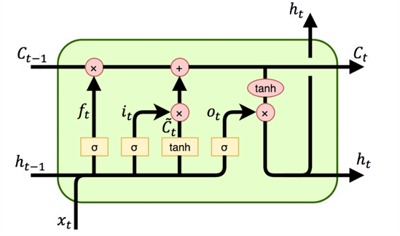
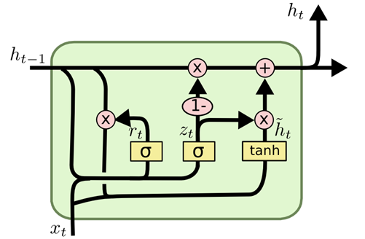
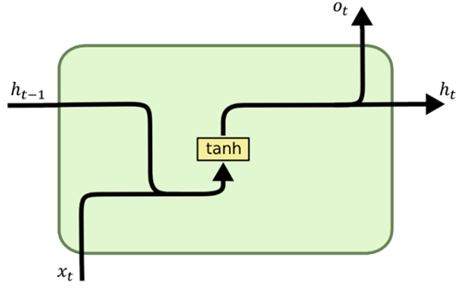
RNN / LSTM / GRU
learn time-dependent information
RNN
(Recurrent neural network)
LSTM
(Long short-term memory)
GRU
(Gated Recurrent Unit)
forget gate
input gate
output gate
reset gate
update gate
Gate is usually a sigmoid function (between 0 & 1)
https://towardsdatascience.com/a-brief-introduction-to-recurrent-neural-networks-638f64a61ff4
32

Slide 33
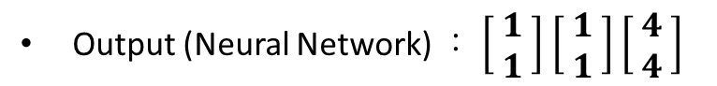


RNN / LSTM / GRU
learn time-dependent information
The models not only consider new input but also take into account the previous output to generate new results.
For example：
Input：$\left[hungry\right]$ $\left[hungry\right] \left[hungry\right]$
Output (RNN)：$\left[KFC\right]$ $\left[MOS\right] \left[McDonald′s\right]$
RNN
(Recurrent neural network)
Output (Neural Network)：$\left[KFC\right] \left[KFC\right]$ $\left[KFC\right]$
For example：
Input ： $\left[\begin{matrix} 1 \\ 1 \end{matrix}\right]$ $\left[\begin{matrix} 1 \\ 1 \end{matrix}\right]$ $\left[\begin{matrix} 2 \\ 2 \end{matrix}\right]$
Output (RNN) ： $\left[\begin{matrix} 1 \\ 1 \end{matrix}\right]$ $\left[\begin{matrix} 2 \\ 2 \end{matrix}\right]\left[\begin{matrix} 6 \\ 6 \end{matrix}\right]$
Output (Neural Network) ： $\left[\begin{matrix} 1 \\ 1 \end{matrix}\right]$ $\left[\begin{matrix} 1 \\ 1 \end{matrix}\right]$ $\left[\begin{matrix} 4 \\ 4 \end{matrix}\right]$
33

Slide 34
RNN / LSTM / GRU
learn time-dependent information
RNN
(Recurrent neural network)
LSTM
(Long short-term memory)
GRU
(Gated Recurrent Unit)
forget gate
input gate
output gate
reset gate
update gate
Gate is usually a sigmoid function (between 0 & 1)
https://towardsdatascience.com/a-brief-introduction-to-recurrent-neural-networks-638f64a61ff4
34

Slide 35
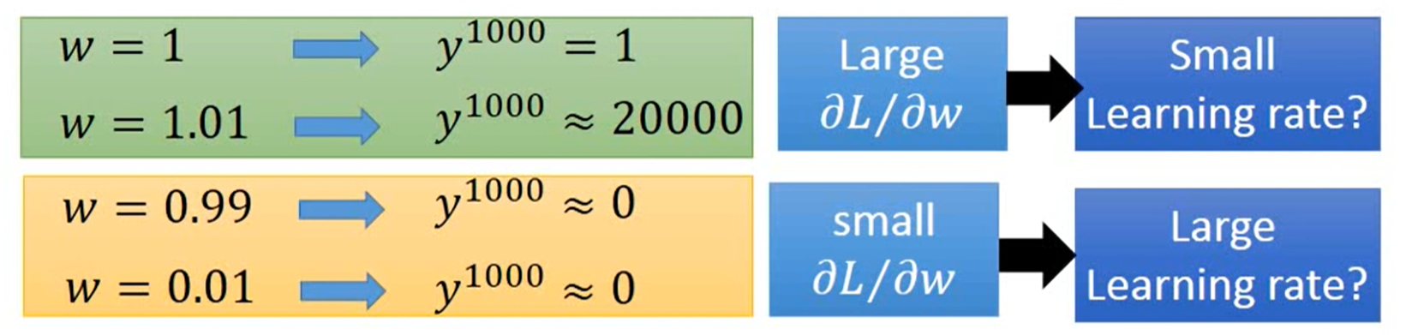
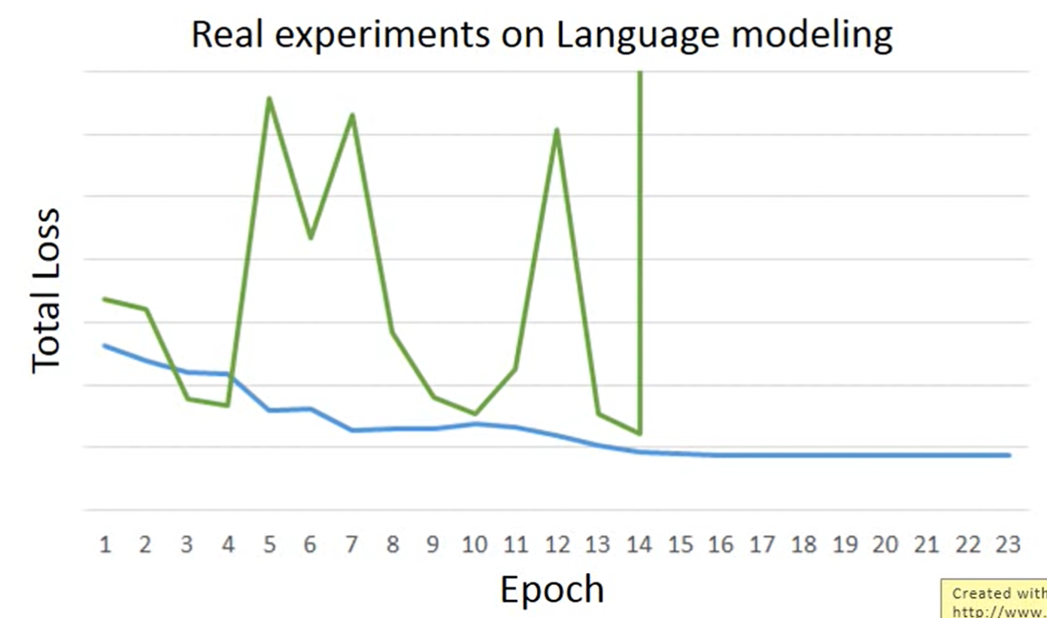
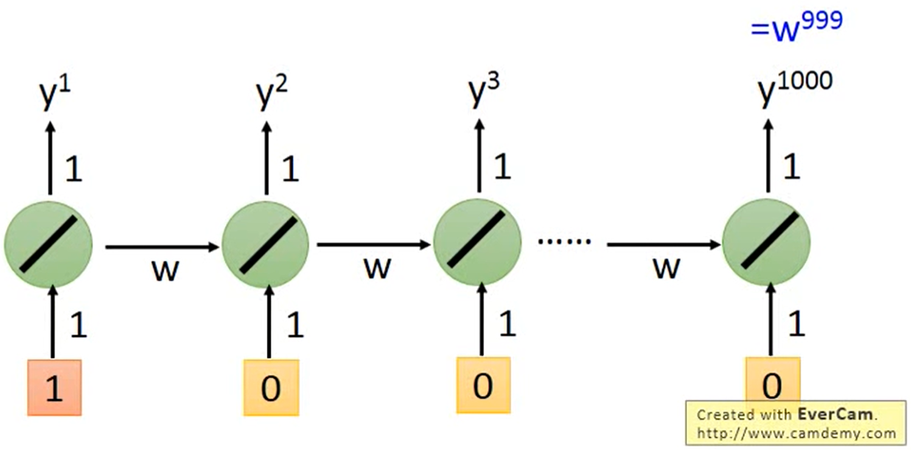
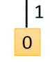
The disadvantages of RNN
It is not always easy to learn.
actuality
Gradient vanishing
normal
Loss = gradient * learning rate

Slide 36
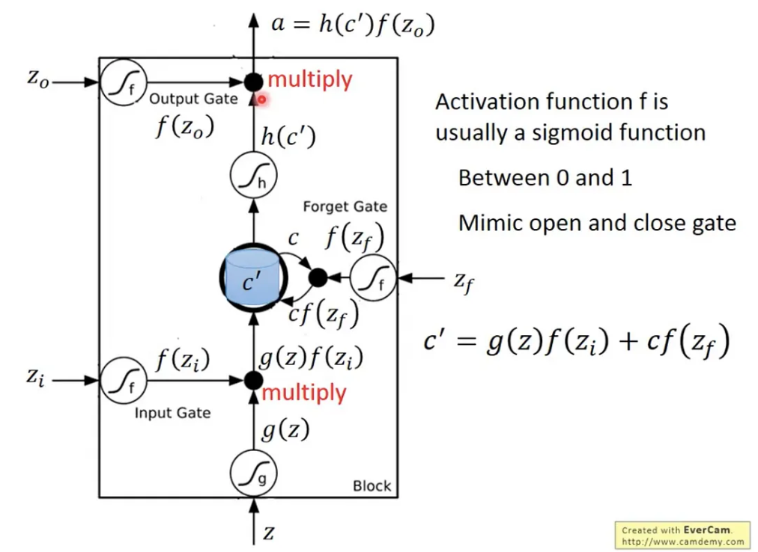
The disadvantages of LSTM
weight3
weight4
weight2
weight1
input1

Slide 37
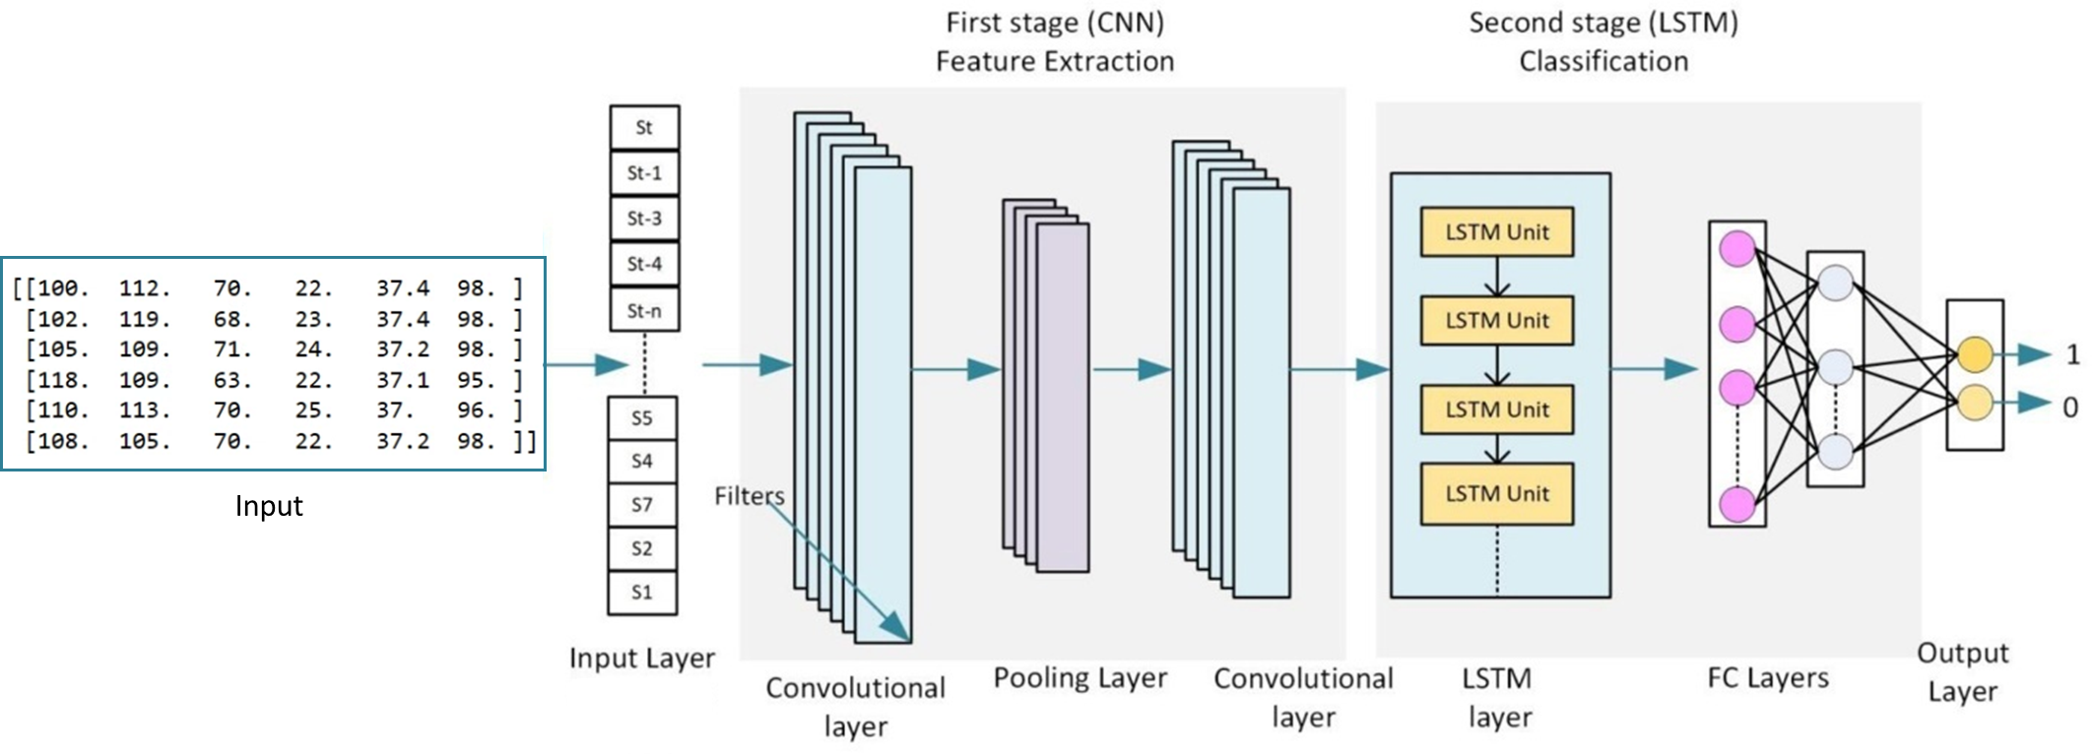
CNN-LSTM
CNN (convolutional neural network) exploits the ability of convolutional layers for extracting useful information and learning the internal representation of time-series data.
Sustainable Energy, Grids and Networks 32 (2022): 100839.
Neural computing and applications 32 (2020): 17351-17360.

Slide 38
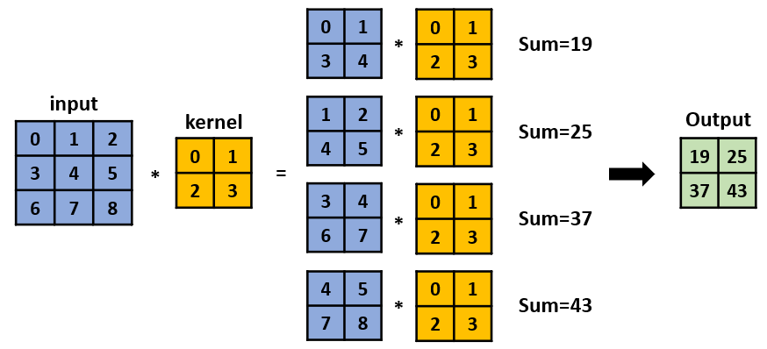
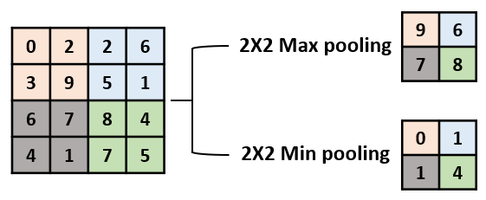
CNN
Convolutional layer
Learn block features
Pooling layer
Compress and retain important information

Slide 39

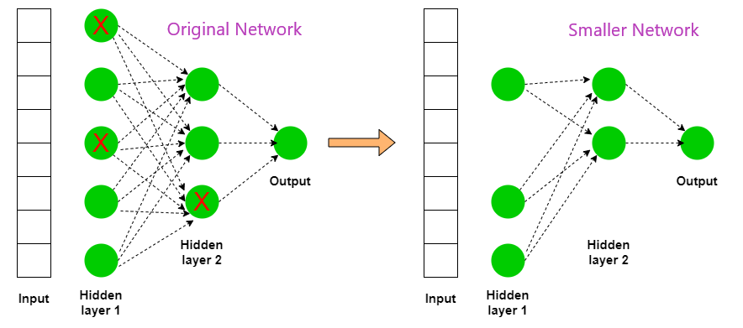
Overfitted
Dropout

Slide 40
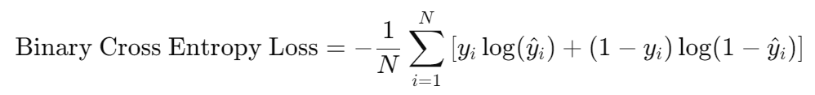
RNN / LSTM / GRU / CNN-LSTM
The hyperparameters for the model were decided after multiple rounds of testing.
Batch_size：64
Epoch：100
Learning rate：0.001
Optimizer：Adam (adaptive moment estimation)
Loss function：binary cross entropy
N is the number of samples.
𝑦𝑖 is the actual label of the 𝑖-th sample, which can be 0 or 1.
ŷ𝑖 is the predicted probability of the 𝑖-th sample being classified as 1.
Total parameters：
RNN：201
LSTM：561
GRU：465
CNN-LSTM：913
40
Notes:
當實際標籤𝑦𝑖 =1，第一部分重要。
若模型預測為1，代表ŷ𝑖接近1，為正確預測。loss就會很小，因為log(1)=0。
若模型預測為0，代表ŷ𝑖 接近0，為錯誤預測。 loss就會很大，因為log(0)=負無窮大。
當實際標籤𝑦𝑖 =0，第二部分重要。
若模型預測為0，代表ŷ𝑖接近0，為正確預測。loss就會很小，因為log(1)=0。
若模型預測為1，代表ŷ𝑖接近1，為錯誤預測。loss就會很大，因為log(0)=負無窮大。

Slide 41
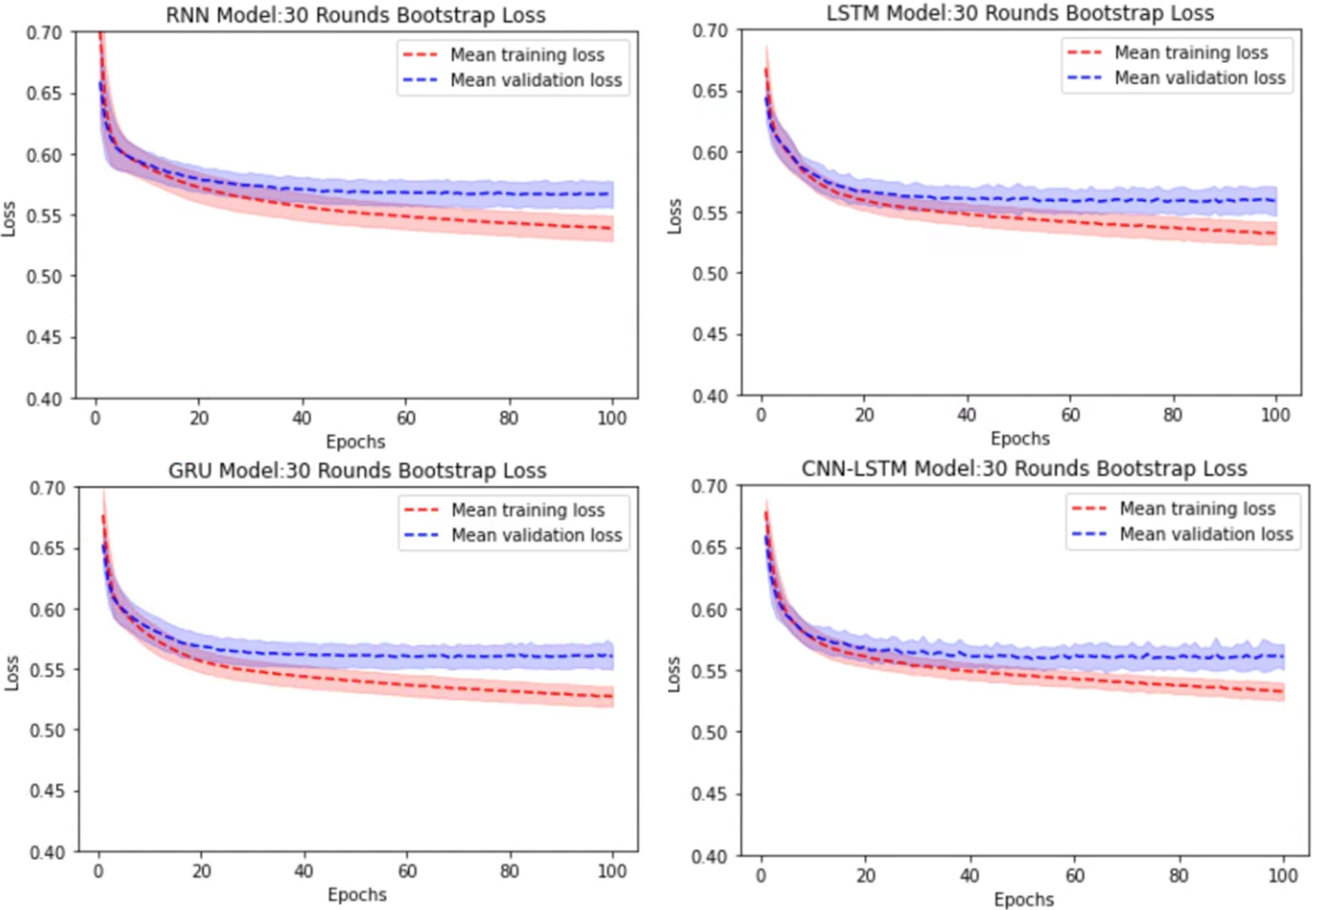
Model stability
Bootstrapping
The closer the model predictions are to the actual results, the loss value will gradually decrease.
41

Slide 42
Overview of study design
MIMC-IV
(Public database)
Data screening
Patients who suffered cardiac arrest
n = 575
Feature extraction
Stay_id, Vital signs, Measured time , CA time
148334 vital signs
Data pre-processing
Outlier detection, Imputation
n =479
68973 vital signs
Select positive/negative samples
From CA / From CA or Non-CA
Model construction and evaluation
RNN, LSTM, GRU & AUROC, F1-score
Feature importance
SHAP
External validation

Slide 43
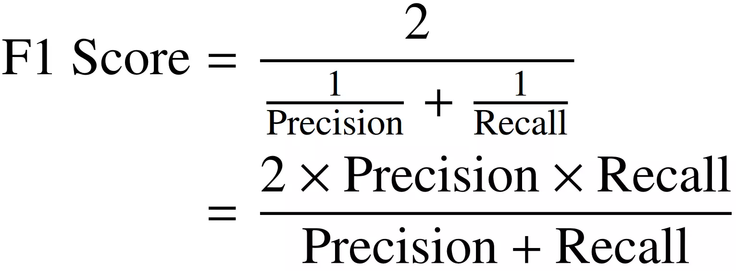
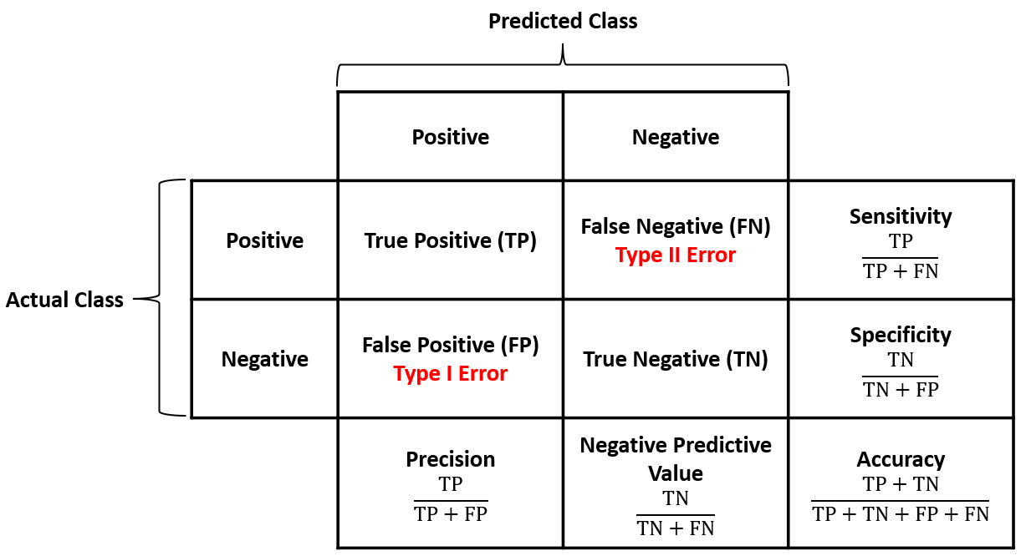
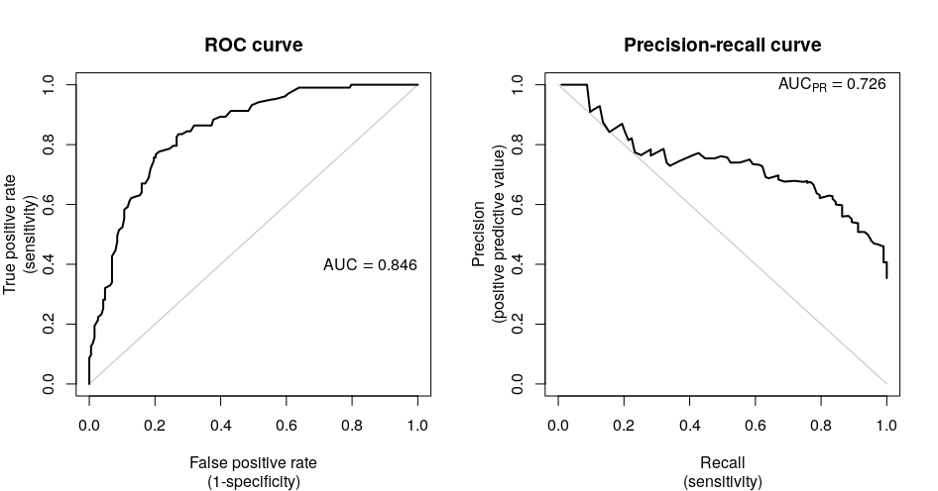
Model evaluation
The closer the value of the metrics is to 1, the better the model performance is.
Accuracy
Precision
Sensitivity (Recall)
Specificity
F1-score
Area Under the ROC (AUROC)
預測有
預測沒有
有發病
TPR=
recall=sensitivity
FPR=
1-specificity
沒發病
Methods in Ecology and Evolution, 10: 565-577
43

Slide 44
Comparison of different models- training , validation data
 | accuracy | precision | sensitivity | specificity | F1-score | AUROC
RNN training | 0.72 ± 0.01 | 0.79 ± 0.01 | 0.67 ± 0.01 | 0.89 ± 0.01 | 0.71 ± 0.00 | 0.79 ± 0.01
RNN validation | 0.70 ± 0.01 | 0.78 ± 0.03 | 0.65 ± 0.03 | 0.88 ± 0.02 | 0.71 ± 0.01 | 0.77 ± 0.01
LSTM training | 0.72 ± 0.01 | 0.79 ± 0.01 | 0.67 ± 0.01 | 0.89 ± 0.01 | 0.71 ± 0.00 | 0.79 ± 0.01
LSTM validation | 0.71 ± 0.01 | 0.78 ± 0.03 | 0.66 ± 0.03 | 0.89 ± 0.02 | 0.71 ± 0.01 | 0.78 ± 0.02
GRU training | 0.72 ± 0.00 | 0.79 ± 0.01 | 0.68 ± 0.01 | 0.90 ± 0.01 | 0.71 ± 0.00 | 0.79 ± 0.01
GRU validation | 0.71 ± 0.01 | 0.77 ± 0.02 | 0.67 ± 0.03 | 0.89 ± 0.02 | 0.71 ± 0.01 | 0.78 ± 0.01
CNN-LSTM training | 0.72 ± 0.01 | 0.78 ± 0.01 | 0.68 ± 0.02 | 0.89 ± 0.01 | 0.71 ± 0.00 | 0.79 ± 0.01
CNN-LSTM validation | 0.71 ± 0.01 | 0.78 ± 0.03 | 0.66 ± 0.04 | 0.89 ± 0.01 | 0.71 ± 0.01 | 0.78 ± 0.01
44

Slide 45
Comparison of different models- training , validation data
 | accuracy | precision | sensitivity | specificity | F1-score | AUROC
RNN training | 0.78 ± 0.01 | 0.80 ± 0.01 | 0.76 ± 0.01 | 0.97 ± 0.01 | 0.67 ± 0.00 | 0.87 ± 0.01
RNN validation | 0.77 ± 0.01 | 0.80 ± 0.02 | 0.74 ± 0.04 | 0.96 ± 0.01 | 0.67 ± 0.01 | 0.86 ± 0.01
LSTM training | 0.79 ± 0.01 | 0.81 ± 0.01 | 0.76 ± 0.01 | 0.97 ± 0.00 | 0.67 ± 0.00 | 0.88 ± 0.01
LSTM validation | 0.78 ± 0.01 | 0.80 ± 0.02 | 0.75 ± 0.04 | 0.97 ± 0.01 | 0.67 ± 0.02 | 0.87± 0.01
GRU training | 0.79 ± 0.01 | 0.82 ± 0.01 | 0.76 ± 0.01 | 0.97 ± 0.00 | 0.67 ± 0.00 | 0.88 ± 0.01
GRU validation | 0.78 ± 0.01 | 0.81 ± 0.03 | 0.76 ± 0.05 | 0.97 ± 0.01 | 0.67 ± 0.01 | 0.88 ± 0.01
CNN-LSTM training | 0.79 ± 0.01 | 0.81 ± 0.01 | 0.77 ± 0.01 | 0.97 ± 0.00 | 0.67 ± 0.00 | 0.88 ± 0.00
CNN-LSTM validation | 0.79 ± 0.01 | 0.82 ± 0.03 | 0.75 ± 0.05 | 0.97 ± 0.01 | 0.67 ± 0.01 | 0.88 ± 0.01
45

Slide 46

Comparison of different models with different compositions of negative samples-test data
 | accuracy | precision | sensitivity | specificity | F1-score | AUROC
RNN | 0.69 | 0.81 | 0.62 | 0.79 | 0.70 | 0.78
LSTM | 0.70 | 0.78 | 0.68 | 0.73 | 0.72 | 0.78
GRU | 0.70 | 0.81 | 0.63 | 0.80 | 0.71 | 0.79
CNN-LSTM | 0.70 | 0.77 | 0.67 | 0.73 | 0.72 | 0.79
Positive sample：CA
Negative sample：CA
 | accuracy | precision | sensitivity | specificity | F1-score | AUROC
RNN | 0.78 | 0.81 | 0.77 | 0.81 | 0.79 | 0.88
LSTM | 0.79 | 0.83 | 0.76 | 0.83 | 0.79 | 0.89
GRU | 0.79 | 0.87 | 0.70 | 0.88 | 0.77 | 0.89
CNN-LSTM | 0.79 | 0.83 | 0.75 | 0.83 | 0.79 | 0.88
Positive sample：CA
Negative sample：Non-CA
46

Slide 47
Comparison of different models with different compositions of negative samples-test data
 | accuracy | precision | sensitivity | specificity | F1-score | AUROC
RNN | 0.72 | 0.76 | 0.71 | 0.74 | 0.73 | 0.80
LSTM | 0.73 | 0.78 | 0.70 | 0.76 | 0.73 | 0.80
GRU | 0.73 | 0.78 | 0.70 | 0.77 | 0.74 | 0.82
CNN-LSTM | 0.73 | 0.78 | 0.69 | 0.76 | 0.73 | 0.81
Positive sample：CA
Negative sample：half
(CA + Non-CA)
The sample sources can match real-world conditions.
The models can learn from a more diverse range of vital signs trends.
The predictive performance of the models remains at a consistent level.
External validation

Slide 48
Comparison of different models
The performance of these four deep learning models is similar across various metrics, indicating that changes in model architecture do not have a major impact on the data used in this study.
GRU model achieves the best model performance and sets fewer parameters
 | accuracy | precision | sensitivity | specificity | F1-score | AUROC
GRU_CA | 0.73 | 0.80 | 0.64 | 0.82 | 0.71 | 0.80
GRU_Non-CA | 0.81 | 0.86 | 0.72 | 0.89 | 0.78 | 0.89
GRU_half | 0.75 | 0.78 | 0.70 | 0.80 | 0.74 | 0.85
Total parameters：
RNN：201
LSTM：561
GRU：465
CNN-LSTM：913

Slide 49
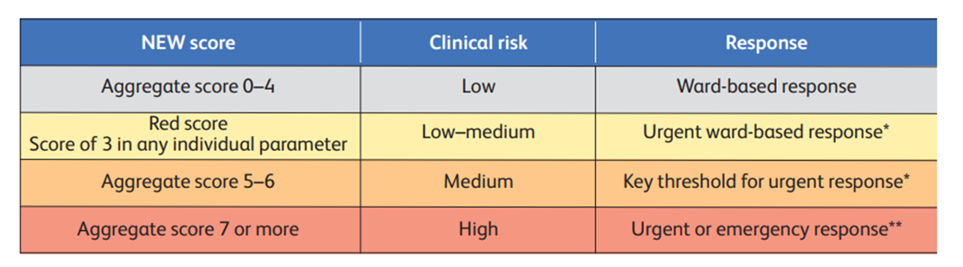
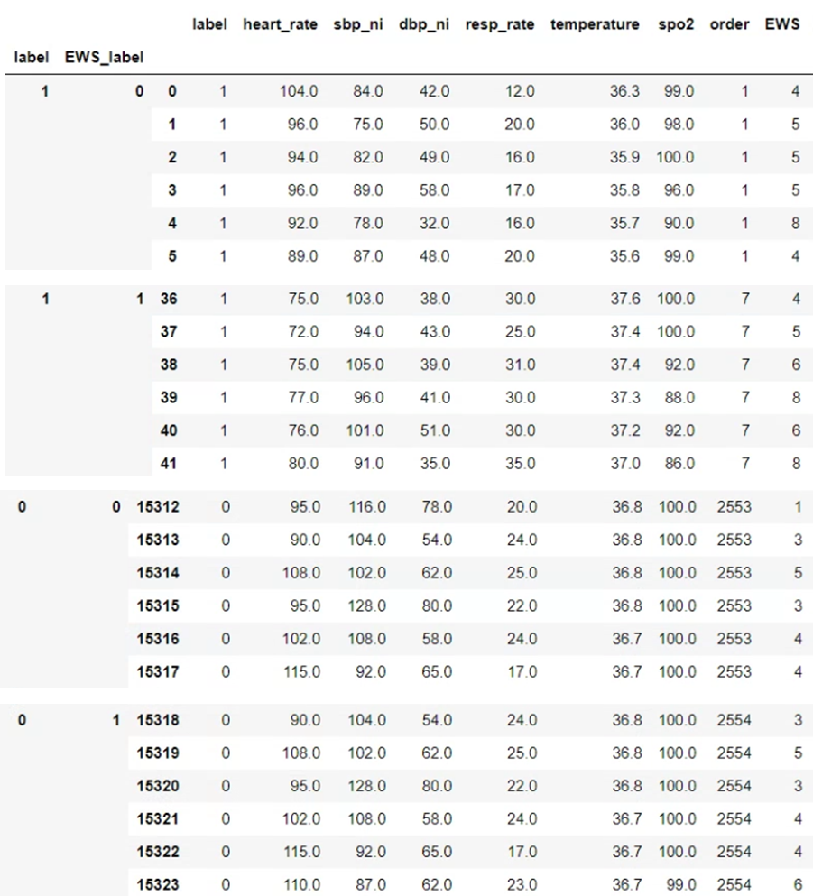
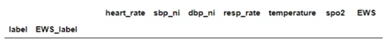
Application of the NEWS to positive and negative samples
National Early Warning System (NEWS)
For example：
False
Negative
(FN)
True
Negative
(TN)
True
Positive
(TP)
False
Positive
(FP)
49

Slide 50

The predictive performance of NEWS and GRU with different compositions of negative samples
 | accuracy | precision | sensitivity | specificity | F1-score | AUROC
NEWS_CA | 0.59 | 0.60 | 0.60 | 0.59 | 0.60 | 0.59
NEWS_Non-CA | 0.73 | 0.75 | 0.60 | 0.84 | 0.67 | 0.72
NEWS_half | 0.67 | 0.67 | 0.60 | 0.74 | 0.63 | 0.67
Our research
 | accuracy | precision | sensitivity | specificity | F1-score | AUROC
GRU_CA | 0.73 | 0.80 | 0.65 | 0.81 | 0.72 | 0.80
GRU_Non-CA | 0.80 | 0.82 | 0.78 | 0.82 | 0.77 | 0.88
GRU_half | 0.75 | 0.78 | 0.68 | 0.81 | 0.73 | 0.83
half：The negative samples consist of equal parts data from CA patients and non-CA patients.
50

Slide 51
Overview of study design
MIMC-IV
(Public database)
Data screening
Patients who suffered cardiac arrest
n = 575
Feature extraction
Stay_id, Vital signs, Measured time , CA time
148334 vital signs
Data pre-processing
Outlier detection, Imputation
n =479
68973 vital signs
Select positive/negative samples
From CA / From CA or Non-CA
Model construction and evaluation
RNN, LSTM, GRU & AUROC, F1-score
Feature importance
SHAP
External validation

Slide 52
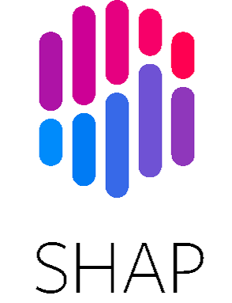
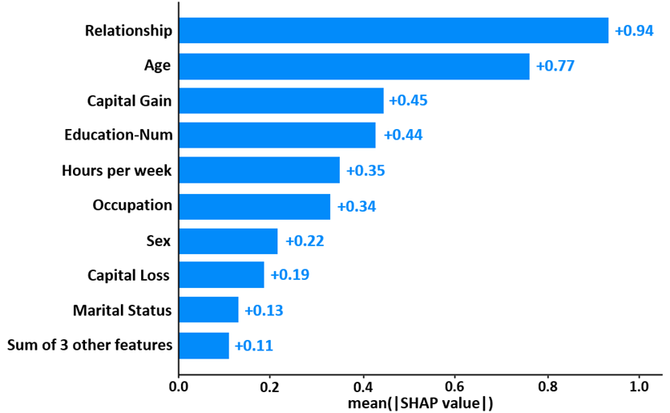
Feature importance
SHAP (SHapley Additive exPlanations) is a game theoretic approach to explain the output of any machine learning model. It can use the Shapley value to measure the specific contribution of each feature to the model prediction.
https://shap.readthedocs.io/en/latest/

Slide 53
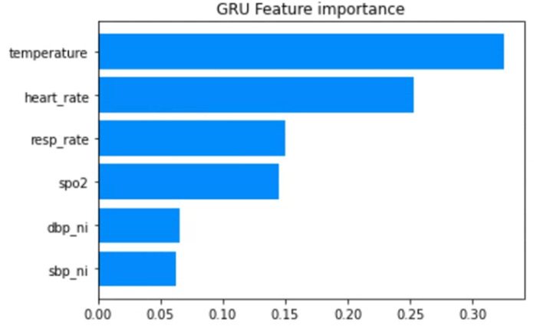
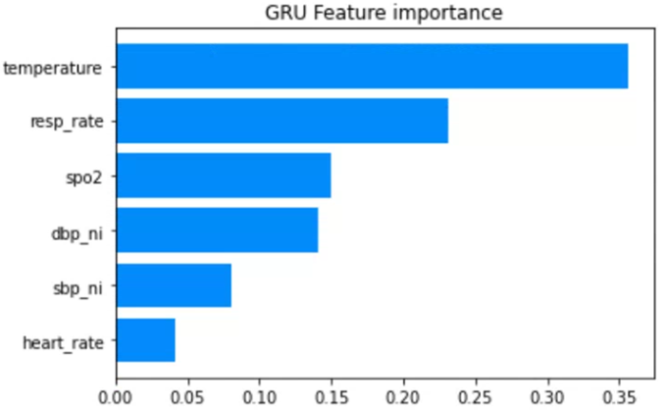
Feature importance (SHAP)
Positive sample：CA
Negative sample：CA
Positive sample：CA
Negative sample：Non-CA

Slide 54
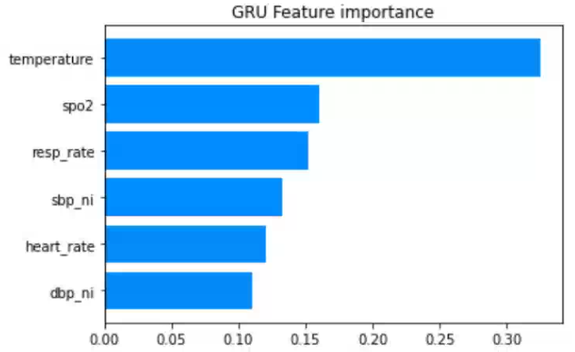
Feature importance (SHAP)
Positive sample：CA
Negative sample：half
(CA + Non-CA)
Body temperature and respiratory rate are the most important features for predicting outcomes with the GRU model.
Approximately 60% of patients will experience abnormalities in respiratory rate, heart rate, and systolic blood pressure within 1 to 4 hours before a cardiac arrest.
Frei, et al. indicate that hypothermia in patients may lead to cardiac arrest and is associated with a higher mortality rate.
Resuscitation, 2016. 98: p. 112-117.
Resuscitation, 2019. 137: p. 41-48.

Slide 55
Overview of study design
MIMC-IV
(Public database)
Data screening
Patients who suffered cardiac arrest
n = 575
Feature extraction
Stay_id, Vital signs, Measured time , CA time
148334 vital signs
Data pre-processing
Outlier detection, Imputation
n =479
68973 vital signs
Select positive/negative samples
From CA / From CA or Non-CA
Model construction and evaluation
RNN, LSTM, GRU & AUROC, F1-score
Feature importance
SHAP
External validation
55

Slide 56

External validation
ICU, emergency room, general ward
642 cardiac arrest (596 persons)
19331 vital signs
2016-2021
Medical information on CA patients
Select the data of patients with cardiac arrest in general ward
General ward
179 cardiac arrest (178 persons)
4055 vital signs
感謝郭主任、余醫師、張醫師、鄭醫師、芳如學姐協助資料申請

Slide 57

Data pre-processing
Remove some data according to the following rules :
Use linear interpolation to impute missing values for each patient with missing data.
If there are data points that cannot be imputed, use the mean of that feature for each patient to fill in the missing values.

Slide 58







Data cleaning
Use NA to replace punctuation marks and Chinese characters.
Remove redundant punctuation marks and English letters.
If the value is within a range, change it to the average of this range.
TempC
HR
SpO2
SBP、DBP

Slide 59
External validation
ICU, emergency room, general ward
642 cardiac arrest (596 persons)
19331 vital signs
2016-2021
Medical information on CA patients
Select the data of patients with cardiac arrest in general ward
General ward
179 cardiac arrest (178 persons)
4055 vital signs
After data pre-processing and cleaning
179 cardiac arrest (178 persons)
2622 vital signs
Positive samples：282
Negative samples：560
External test data

Slide 60
Patient characteristics
Dataset | MIMIC IV (CA) | Mackay Hospital (Taipei) (CA) | P-value
Number of total patients, n | 477 | 178
Number of total vital signs, n | 68,973 | 2,622
Age, y , mean ± SD | 65.58 ± 15.91 | 70.70 ± 13.14
Male ,sex , n (%) | 289 (60.59%) | 113 (63.48%)
Features, mean ± SD
SBP (mmHg) | 110.69 ± 22.06 | 124.76 ± 27.05 | p < 0.05*
DBP (mmHg) | 61.96 ± 15.74 | 67.15 ± 14.90 | p < 0.05*
HR (/min) | 89.32 ± 20.88 | 93.53 ± 24.42 | p < 0.05*
RR (/min) | 21.79 ± 6.45 | 19.66 ± 4.12 | p < 0.05*
BT (℃) | 36.94 ± 1.04 | 37.00 ± 1.13 | p < 0.05*
SpO₂(%) | 96.50 ± 4.83 | 374.87 ± 3835.79 | p < 0.05*

Slide 61
External validation
 | accuracy | precision | sensitivity | specificity | F1-score | AUROC
RNN | 0.78 | 0.71 | 0.60 | 0.88 | 0.65 | 0.87
LSTM | 0.72 | 0.55 | 0.96 | 0.60 | 0.70 | 0.85
GRU | 0.76 | 0.63 | 0.74 | 0.78 | 0.68 | 0.87
CNN-LSTM | 0.58 | 0.44 | 0.99 | 0.38 | 0.71 | 0.85
Positive sample：CA
Negative sample：CA
 | accuracy | precision | sensitivity | specificity | F1-score | AUROC
RNN | 0.75 | 0.67 | 0.51 | 0.87 | 0.58 | 0.83
LSTM | 0.72 | 0.55 | 0.96 | 0.61 | 0.70 | 0.86
GRU | 0.76 | 0.64 | 0.65 | 0.82 | 0.65 | 0.84
CNN-LSTM | 0.73 | 0.57 | 0.74 | 0.72 | 0.64 | 0.84
Positive sample：CA
Negative sample：Non-CA
61

Slide 62
External validation
 | accuracy | precision | sensitivity | specificity | F1-score | AUROC
RNN | 0.56 | 0.41 | 0.69 | 0.49 | 0.51 | 0.68
LSTM | 0.76 | 0.60 | 0.87 | 0.71 | 0.71 | 0.88
GRU | 0.75 | 0.58 | 0.93 | 0.66 | 0.71 | 0.86
CNN-LSTM | 0.73 | 0.56 | 0.95 | 0.62 | 0.70 | 0.86
Positive sample：CA
Negative sample：half
(CA + Non-CA)
The model may overestimate the patient's risk status, triggering unnecessary alarms for normal vital signs, thereby leading to a waste of medical resources.
However, the models we trained can still predict most patients who are about to experience cardiac arrest, and the overall predictive performance and F1-score of the model remain within a reasonable range.

Slide 63
Discussion
In research on models for predicting cardiac arrest, exploring the composition of positive and negative samples is crucial for understanding their impact on model performance.
In previous research, the negative samples used for training predictive models were mostly sourced from data of non-CA patients.
Smart Health, 2022. 25: p. 100294.
Computer Methods and Programs in Biomedicine, 2022. 214: p. 106568.
Positive sample：CA
Negative sample：CA
Positive sample：CA
Negative sample：Non-CA
Positive sample：CA
Negative sample：half (CA + Non-CA)
The variability in both pos and neg samples ↓
The performance of the models ↑
The applicability of model in real clinical settings ↑

Slide 64
Discussion
According to our results, GRU outperforms NEWS on multiple performance metrics.
GRU can learn the trends of patient status changes through time-series vital signs data.
NEWS uses a simple static scoring system, which still has limitations when dealing with complex changes in vital signs.
Shamout et al. developed the deep early warning system (DEWS) for predicting clinical deterioration. The model achieved an AUROC of 0.88, whereas NEWS had an AUROC of 0.86.
IEEE J Biomed Health Inform, 2020. 24(2): p. 437-446.
Cho et al. found that the DeepCARS™ system performed better in predicting IHCA than NEWS (AUROC : 0.869 vs. 0.767). Additionally, DeepCARS™ showed significant improvements in recall and specificity.
Crit Care, 2023. 27(1): p. 346.

Slide 65
Discussion
Strength
Our study uses public database MIMIC IV to simulate the measurement frequency and items in general wards, overcoming the current difficulty of obtaining relevant data from general wards.
Our constructed model uses only six vital signs recorded in a day in general wards. These items not only reduce the burden on hospitals in data collection but also make the model easier to implement in the current medical environment.
We investigate the composition of negative samples in training models, which helps ensure the representativeness of the data and enables the model to predict the risk of cardiac arrest in patients.

Slide 66
Discussion
Limitation
Mackay Hospital only provides data for CA patients in general wards, without data from the majority of non-CA patients in general wards for model validation.
We use data from ICU patients to simulate the distribution of data in general wards, but there are indeed differences in patient conditions between the two settings.
Differences among healthcare institutions can impact the treatment processes and disease progression of patients, therefore, the medical data from these patients may affect the performance of predictive models.
Therefore, in the future, it will be necessary to conduct more external validations using data from general wards of other hospitals.

Slide 67
Comparison
 | EWS | TEWS | DeepCARSTM
Year of development | 2015-2024 | 2022 | 2023
algorithms | ML | DL | DL
Predicting disease | IHCA | IHCA | IHCA
Compare | Better than MEWS or NEWS | Better than MEWS | Better than MEWS, NEWS
Features | Demographics, vital signs, laboratory test results | Vital signs | Age, vital signs, recorded time
Shortage | A large number of variables, complex calculations | Lack of age and record time | Too short study period
Validation | Retrospective, single-center | Retrospective, single-center | Prospective, multicenter
TEWS：time-series early warning score
Sci Rep. 2022;12:11901.

Slide 68



Conclusion
Create
Predict
GRU
External validation
【CA patients in general ward】
MIMIV IV
Deep learning-based
early warning system
CA patients in
general ward
win
Feature importance
NEWS (Traditional trigger system)
68

Slide 69
Acknowledgments
指導老師：巫坤品教授
口試委員：王禹超教授、葉宏一醫師
馬偕醫院：郭立國主任、余貫本醫師、張暐弘醫師、鄭廣華醫師、孫芳如學姐
實驗室夥伴：黃文毅學長、柯艾彤學姐、林菀純同學、竺佩蓁同學、王彥然同學、陳霈芯學妹、梁維真學妹等人
感謝指導老師和口試委員們在論文上提供我寶貴的指導和建議，
感謝馬偕醫師們和學姐協助一般病房資料的申請，
感謝實驗室各位夥伴在研究上給予我幫助和鼓勵。

Slide 70
Thanks for your attention!

